Slide 1
Discussion 1: Introduction to Java
Christine Zhou

Slide 2
Agenda
Introductions & About Me
Announcements
Worksheet!

Slide 3
Introductions & About Me
Christine, 4th year
Email: cazhou@berkeley.edu
Feel free to email me!
Always available to chat one-on-one
I love teaching!
This is my seventh time teaching CS 61B(L) :O
What is your name, year (interesting fact)?

Slide 4
Announcements
HW 0 is out! (optional)
Take a look if you’re new to Java/coding
Lab 1 has been released
You will have time to work on this during lab this week
Read EVERYTHING, do not skip steps!
Due next Friday 2/1
Project 0 out tomorrow, intro to Java
Lecture is in Zellerbach at 7 PM for tomorrow only
Discussion/lab calendars on the website soon (info can be found on Piazza)
Pre-semester survey available, 8 points of EC, do ASAP
No office hours this week, will start next week
Discussion survey: tinyurl.com/cz-disc1-sp19

Slide 5
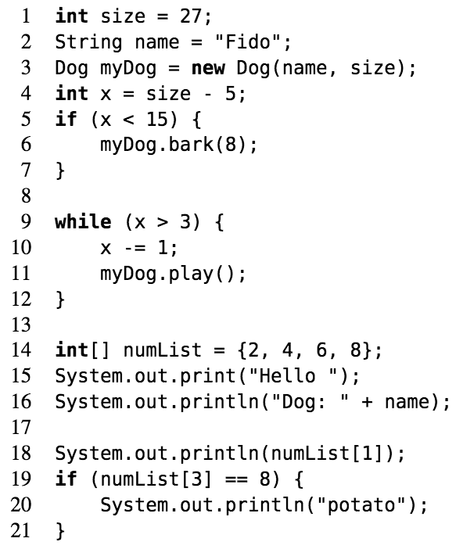
Our First Java Program

Slide 6
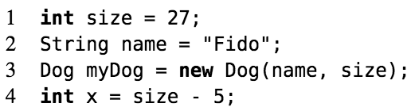
Our First Java Program (continued)

Slide 7
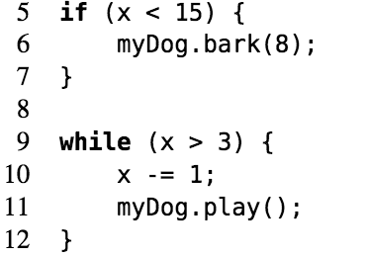
Our First Java Program (continued)

Slide 8
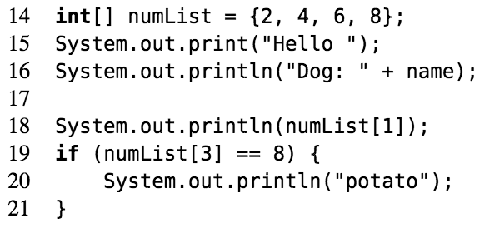
Our First Java Program (continued)

Slide 9
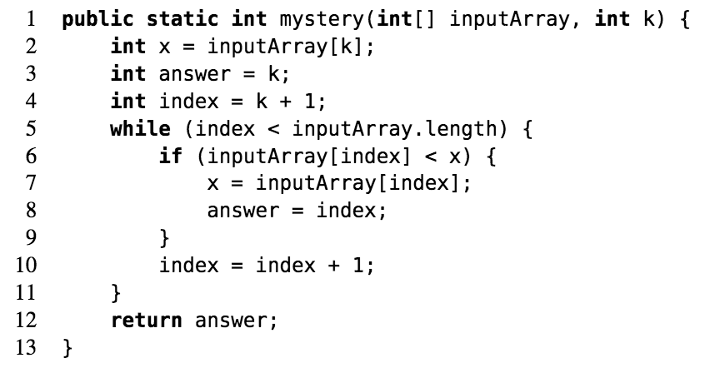
Mystery
Describe in English what mystery returns if inputArray = [3, 0, 4, 6, 3] and k = 2.

Slide 10
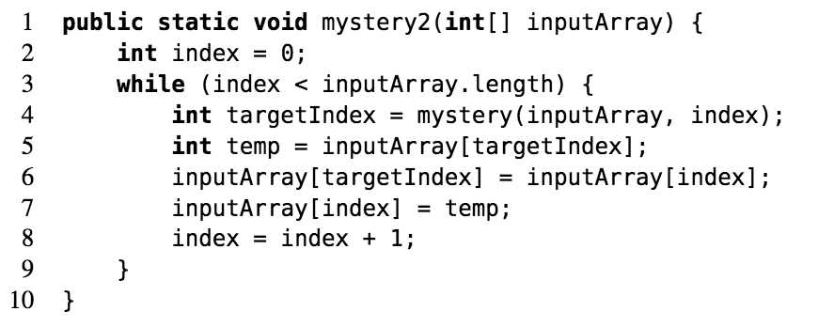
Extra: Mystery
Describe what mystery2 returns if inputArray = [3, 0, 4, 6, 3].

Slide 11
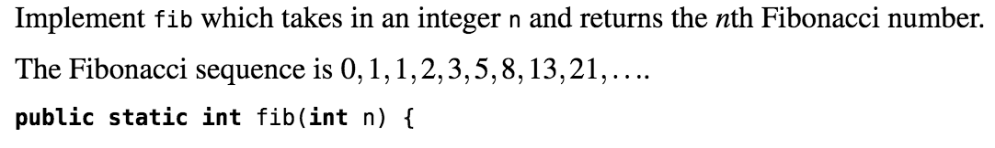
Writing Your First Program

Slide 12
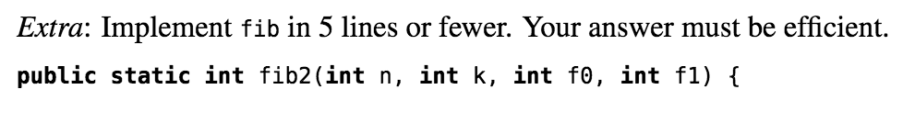
Extra: Writing Your First Program

